Slide 1

Accessibility Standards Prerequisite for accessible reading
Avneesh Singh
Chief Operating Officer, DAISY Consortium
Member of Advisory Board, W3C

Slide 2

Why accessibility standards are so important?
Accessible reading experience is dependent on interaction of three components:
Content
Rendering software supported by operating system accessibility
Assistive technology

Slide 3
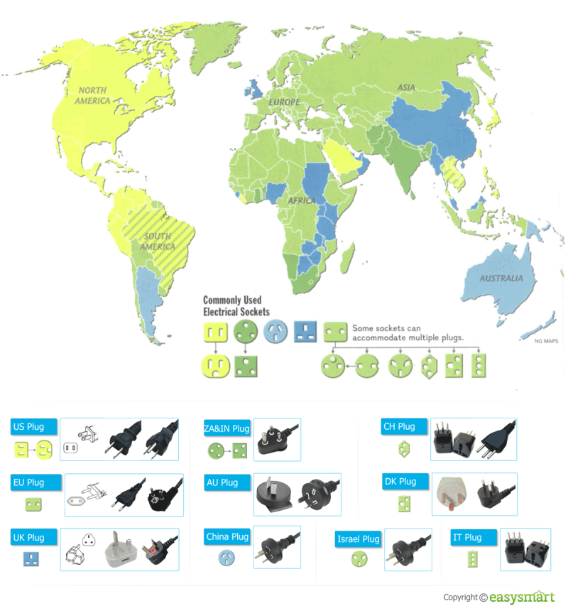
Should we create a specialized accessibility standard?

Slide 4
Standards for Accessible Content
Unicode
Web technologies (HTML/CSS): WCAG and ARIA
EPUB 3: EPUB Accessibility Conformance and Discoverability
PDF: PDF/UA (ISO 14289)
NISO Z3986 (DAISY standard)

Slide 5
STEM Content
MathML (now supported by all major web browsers, MathJax and MathCat):
https://inclusivepublishing.org/mathMLBestPractices
Extended descriptions:
https://inclusivepublishing.org/ExtendedDescriptionsBestPractices
HTML 5 provides one of the best reading experience.

Slide 6
What about domain specific requirements?
Build on international standards to extent possible.
Work with international standards bodies for incorporating domain specific requirements in the international standards.

Slide 7
Revolutionary Era
We are in beginning of a revolution, we have a great opportunity to achieve the era of universal accessibility in research papers.
Lets come along for common worldwide standards for accessibility.

Slide 8
Thank you.
asingh@daisy.org
For more information you can visit :
http://www.w3.org/
https://inclusivepublishing.org/
http://www.daisy.org/

